Slide 1


Slide 2
Acknowledgement
I would like to express my special thanks of gratitude to my teacher Dr Dhanpratap Singh
who gave me the golden opportunity to do this wonderful project on the topic Website Of a Restaurant.
which also helped me in doing a lot of Research and i came to know about so many new things I am really thankful to them. Secondly i would also like to thank my parents and friends who helped me a lot in finalizing this project within the limited time frame.

Slide 3


Slide 4
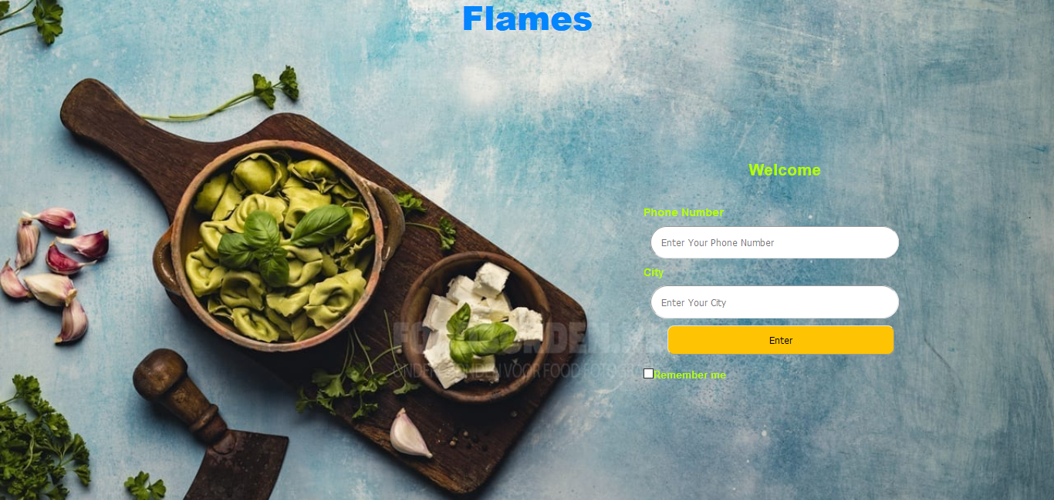
The Welcome page of the Website which takes the user to the Home page with the help of Number and Place name .

Slide 5
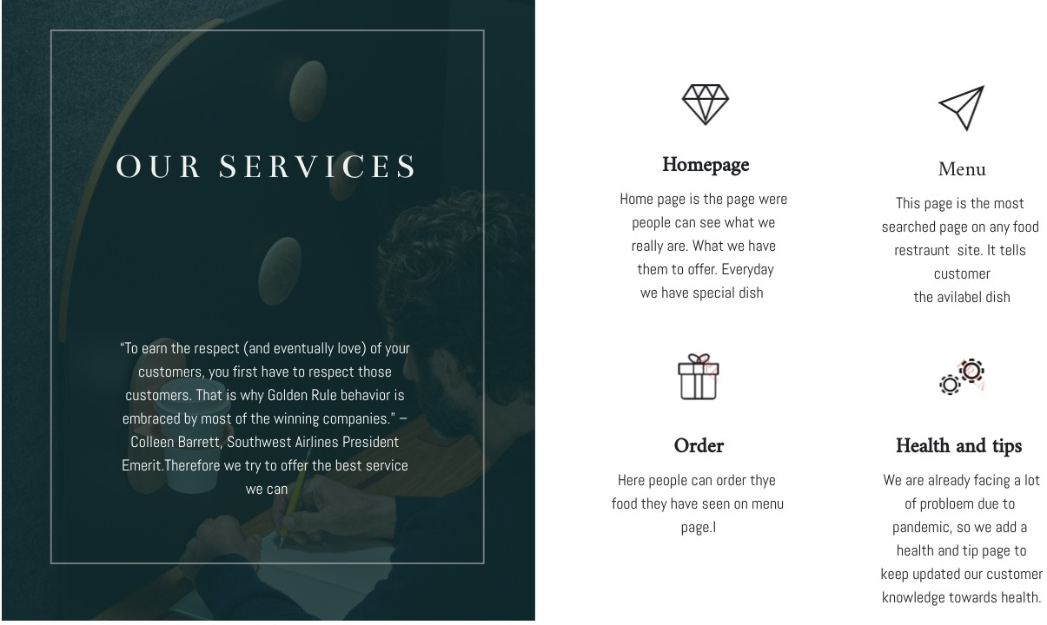

Slide 6


Slide 7


Slide 8
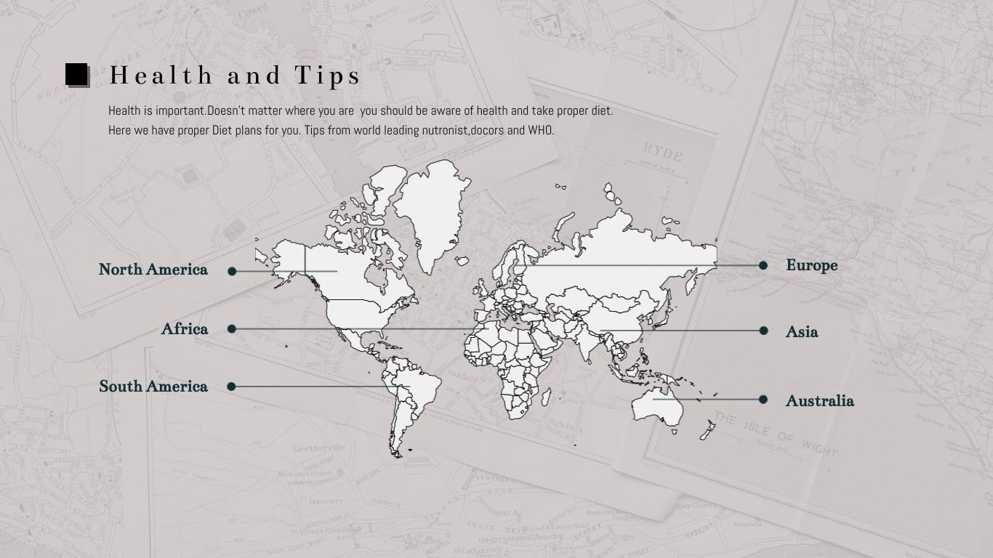

Slide 9

Health and Tips Page

Slide 10

Menu Page

Slide 11
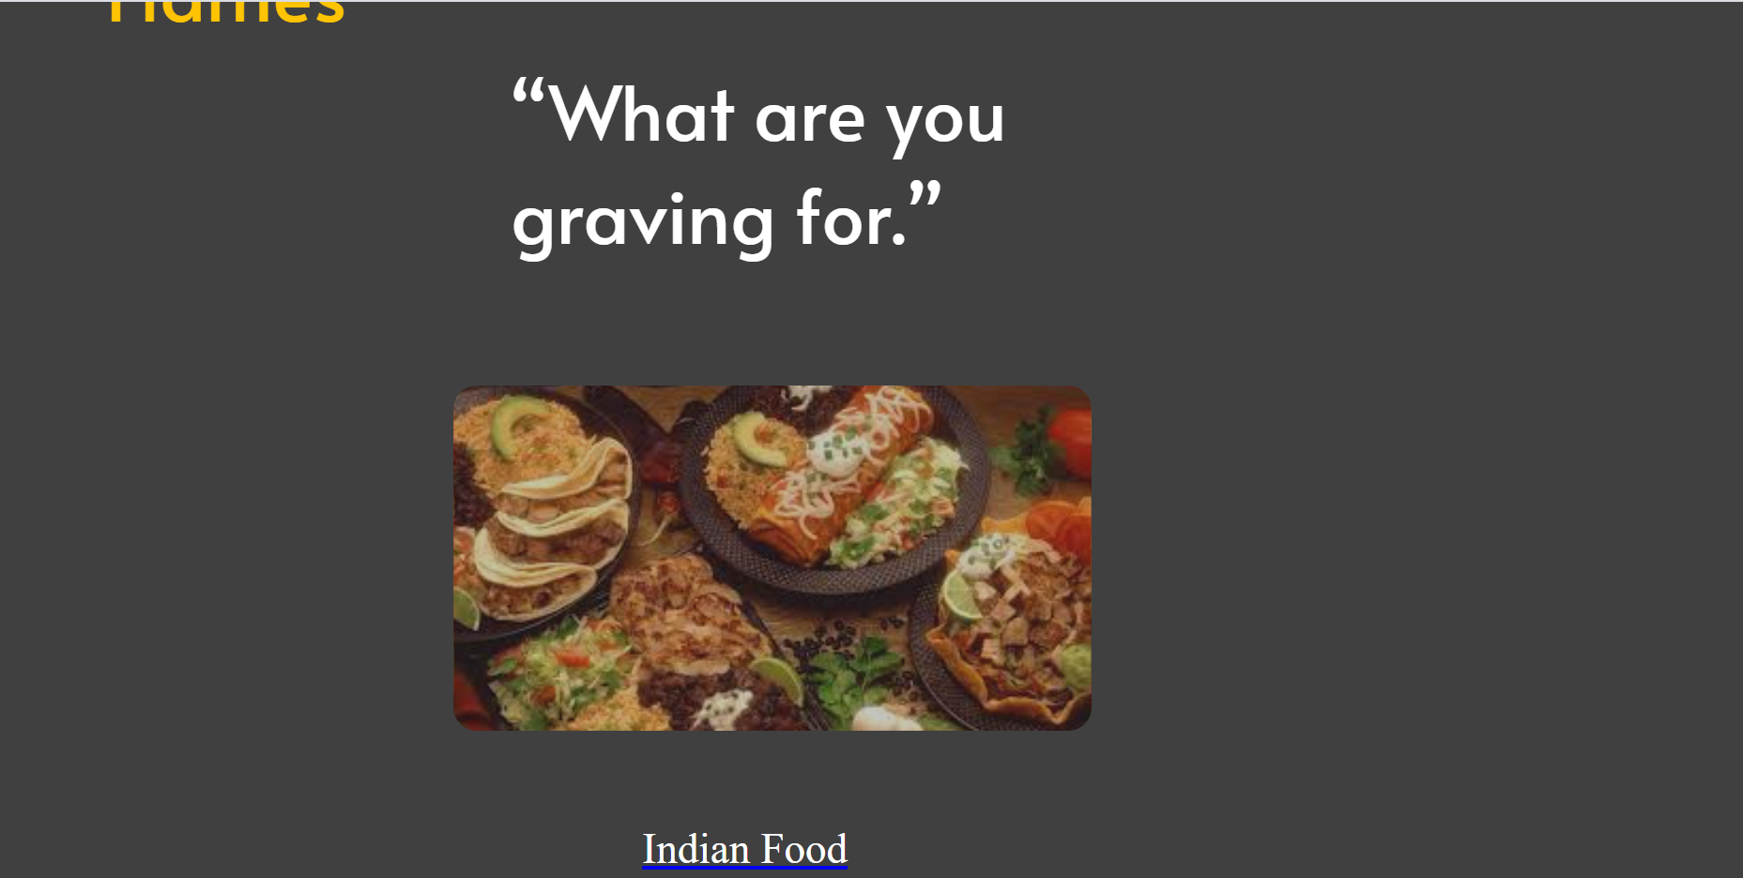
Order Page

Slide 12


Slide 13
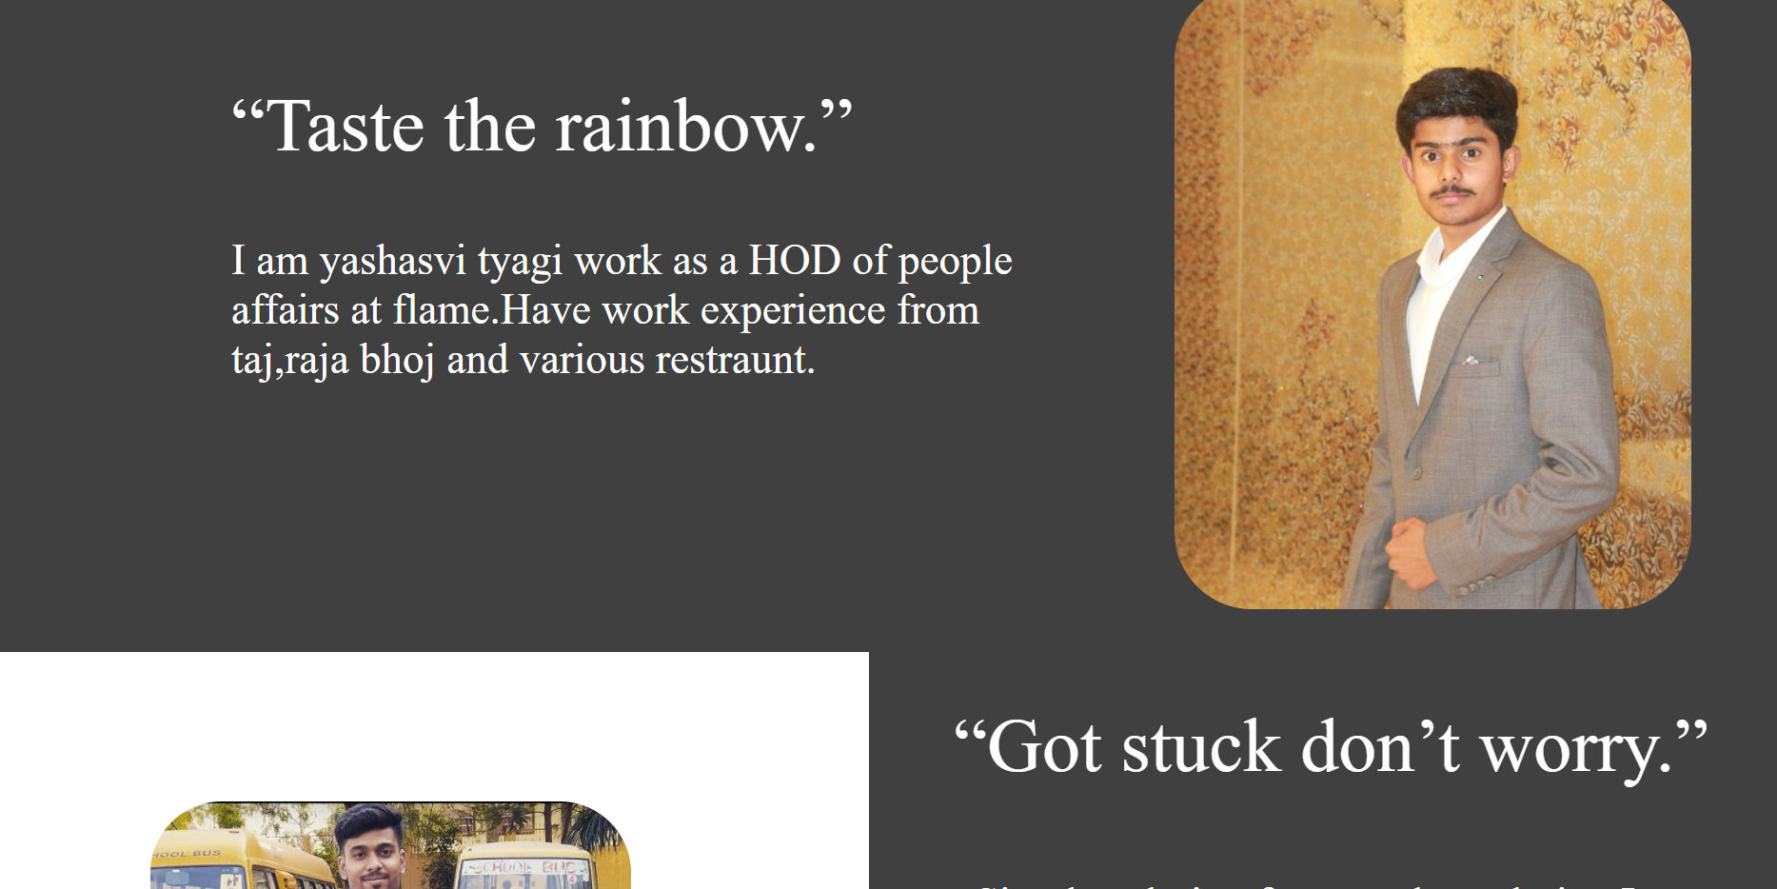
About us
Page

Slide 14
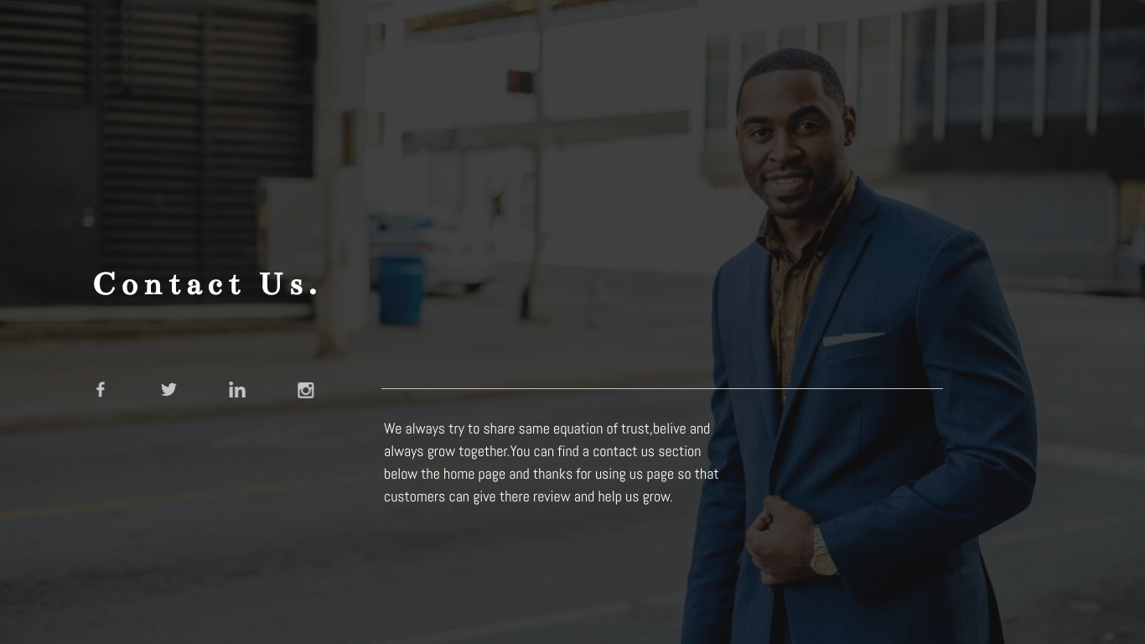

Slide 15


